Slide 1



Python Project for Data Analysis
This project focuses on exploratory data analysis in Python, covering the process from data collection to deriving insights. It utilizes popular libraries such as numpy, pandas, seaborn, and matplotlib.
by Daksh Sharma

Slide 2

Index
Problem Statement
Project Overview
Tools & Libraries
Wow Factor
Diagrams and Charts
Conclusion and Result
Future Scope

Slide 3

Problem Statement
An e-commerce company has provided a dataset containing information about their online retail sales. The company wants to gain actionable insights from this data to optimize their business strategies, improve customer experience, and maximize revenue.

Slide 4




Project Overview - Introduction
Understanding the Data
Initial exploration of the dataset to gain insights into what it contains.
Data Preprocessing
Steps taken to clean, organize, and prepare the data for analysis.
Exploratory Analysis
An overview of the techniques used for exploring the dataset including graphs and plots.

Slide 5

Tools and Libraries Used
Numpy
Pandas
An essential library for performing mathematical operations on arrays and matrices.
Used for data manipulation and analysis, especially for working with structured data.
Seaborn & Matplotlib
These libraries allow for data visualization, making it easier to interpret and present findings.

Slide 6

Wow Factor in Project
1
Data Visualization
Presenting data insights through compelling visualizations.
2
Unveiling the Hidden
Through EDA, the data comes alive, revealing patterns, trends, and relationships that can inform decisions and spark curiosity.
3
Insight Generation
Deriving actionable insights for decision-making based on the data.

Slide 7
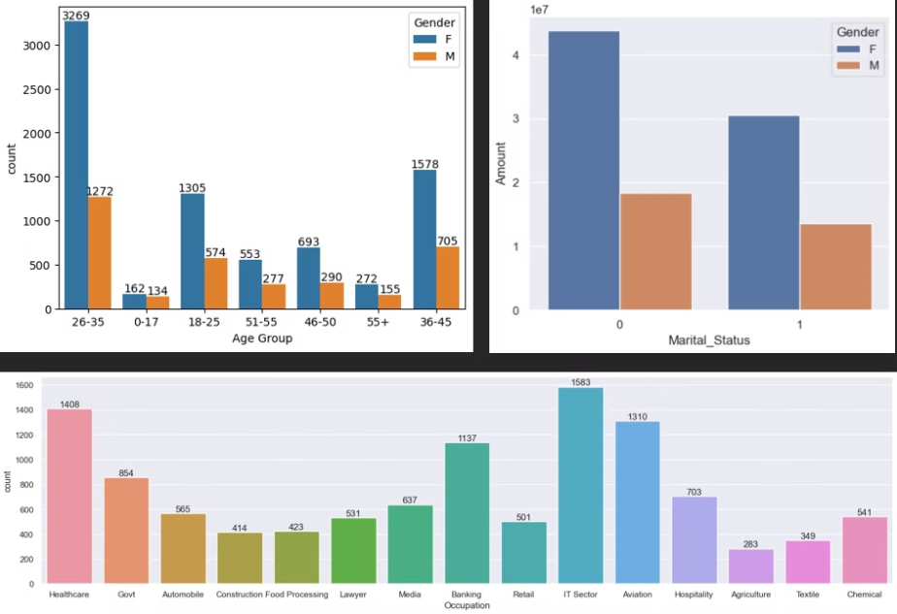
Diagrams and Charts

Slide 8
Conclusion
The charts and visualizations act as a guide, helping to understand how the data is distributed and how different elements interact with each other. Statistics are also employed to summarize the data's key characteristics. Ultimately, the project results in a deep understanding of the data, with insights that can be used for various purposes.
Result
Married women age group 26-35 yrs from UP, Maharashtra and Karnataka working in IT, Healthcare and Aviation are more likely to buy products from Food, Clothing and Electronics category.

Slide 9
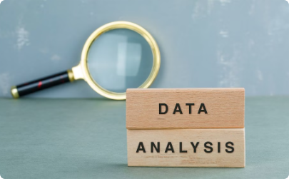
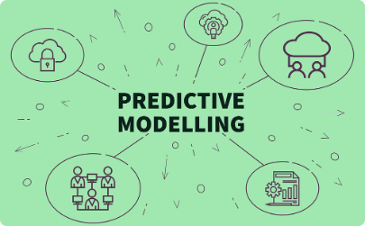

Future Scope
Domain specialization
Predictive Power
Machine Learning
This project sets the stage for delving deeper into a specific field. Imagine focusing on finance and using your newfound EDA skills to analyze market trends, predict stock performance, or assess risk factors.
Use uncovered patterns to build models that predict future outcomes. Analyze customer data to forecast buying habits or study weather patterns to predict potential storms.
Combine EDA with machine learning's power. These algorithms automate tasks and unearth intricate data patterns, allowing you to tackle even more complex problems.

